Slide 1
Thank you for joining us, we will get started in just a few minutes to allow others to call in.
Please make sure your line is muted.
To receive the slides shared today please email COProviderRelations@BeaconHealthOptions.com

Slide 2
May Provider Support Call
May 2020
Notes:
How to change Photos in this PPT:
Select photo
Right click > Format Picture
Select Fill > Picture or Texture fill
Select replacement photo from desired destination
To resize: Select Format Picture > Crop > Fill . Then you can position and resize the source photo as needed using white anchor points around the gray box.

Slide 3
Agenda
01 | Member Attribution
02 | Attribution Methodology
03 | Data Analytics Portal
04 | Member Dismissal
05 | Questions & Open Discussion
Notes:
The text in this slide is in a table. To make changes: simply add/delete rows as necessary.
Do not delete any columns.

Slide 4
Member Attribution
01
Notes:
Every Friday in the month of April we will conduct a Provider Support Call

Slide 5
Why is Member Attribution Important?
Why is it important for Members?
Members are required to be enrolled into ACC 2.0
Ensures all members have a medical home
Enable HCPF to track the care of the member
Why is it important for PCPs?
RAE may use it to calculate PCMP’s PMPM payment
Utilized for PCMPs participating in HCPF’s Alternative Payment Model (www.CO.gov/hcpf/primary-care-payment-reform-3)
Enables HCPF to track provider and RAE performance

Slide 6
Terms and Definitions Related to Member Attribution
Enrollment
Registering Medicaid Members into the Accountable Care Collaborative (ACC).
Assignment
Method used to connect Medicaid Member to their RAE. The PCMP attribution will determine the RAE assignment.
Attribution
Method used to link Medicaid Member to their PCMP, or medical home.
Auto-Attribution
Auto-attribution occurs when Medicaid Member is systematically assigned to a PCMP.

Slide 7
Billing IDs for EACH of your Practice Locations
Member Attribution will be determined by using the Billing ID
PCPs MUST have ONE Billing ID for EACH practice location
EACH claim MUST include the service location address and Billing ID.
Claims should NOT use one billing address for all locations.
For information on how to enroll individual practice locations go to: www.CO.gov/HCPF/Interchange-Resources25

Slide 8
How are Members Attributed?
New Members
New Health First Colorado members, including members who have lost Health First Colorado eligibility for more than 60 days, will be attributed using the methodology based on Utilization, Family Connection, Proximity, & Member Choice with an enrollment broker.
Member loses eligibility
Medicaid rules dictate that if a member loses and regains eligibility within 60 days, they will be reattributed with the same PCMP. Members who lose eligibility for 60 days or more will be treated as a new enrollment and will be attributed using the methodology based on Utilization, Family Connection, Proximity, & Member Choice with an enrollment broker.

Slide 9
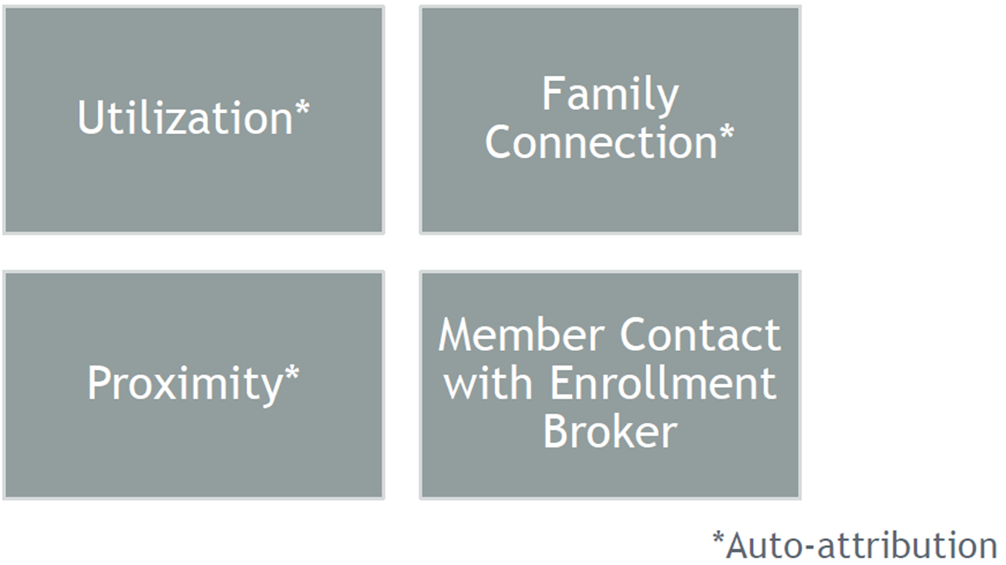
02
Attribution Methodology

Slide 10
Utilization (Auto-Attribution):
If a Medicaid Member has a demonstrated claims history with a PCMP over the last 18 months, the system will automatically attribute the member to that location.
The system first looks at paid Evaluation and Management (E&M) claims, then other types of claims are considered. For children up to age 21, a set of 10 preventive codes will be prioritized.

Slide 11
Utilization (Auto-Attribution):
E&M Codes used for Auto-Attribution include the following:
99201-99205
99211-99215
99381-99387
99391-99397
Children’s preventive services codes used for Auto-Attribution include the following:
99381-99385
99391-99395

Slide 12
Family Connection (Auto-Attribution)
If a member has no utilization history with a PCMP within the past 18 months, the system will look at whether a family member has a claims history with a PCMP and will attribute the member to the family member’s PCMP. This attribution will occur only if the PCMP is appropriate. For example, a parent will not be attributed to a child’s PCMP if that PCMP is a pediatrician. Family relationships will be assumed when a member shares last name, street address, city, ZIP code (5-digit), and county code.

Slide 13
Proximity (Auto-Attribution)
If neither a member nor a family member has a utilization history with a PCMP, the system will determine the closest appropriate PCMP within the member’s region and attribute to that location.
For Phase II, because attribution will drive the RAE assignment, all members must be attributed to a PCMP.

Slide 14
Member Contact with the Enrollment Broker
All members will first be attributed to PCMP using one of the following methods:
Utilization,
Family Connection, or
Proximity
Once the member is attributed, then:
Members can change their PCMP at any time by contacting the Health First Colorado enrollment broker at 1-888-367-6557

Slide 15
Reattribution
Every six (6) months HCPF will conduct a reattribution process to ensure PCMP attributions reflect the member’s strongest PCMP relationship.
The reattribution process will prioritize attributions made when the member contacted the Health First Colorado enrollment broker if that contact was within the 18 month look-back. If the member contacted the Health First Colorado enrollment broker outside of the 18 month look-back, and the client has a stronger claims history with a different provider, the member will be reattributed to the new provider whom they have been seeing.

Slide 16
03
Data Analytics Portal
Notes:
Every Friday in the month of April we will conduct a Provider Support Call

Slide 17
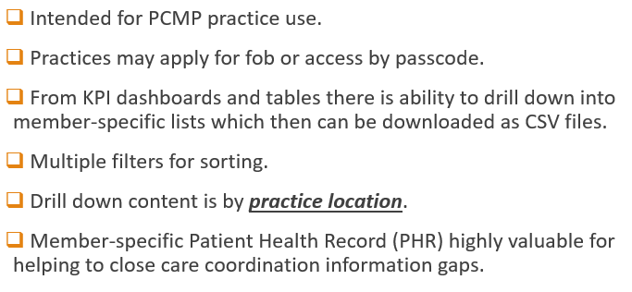
Data Analytics Portal Uses

Slide 18
Request Data Analytics Portal (DAP) access
Send email to your PR Contact or E-mail: COProviderRelations@beaconhealthoptions.com
Include the following information of your request:
PCMP Name and Medicaid ID(s)
Requestor Full Name, Title and Email
Manager’s Full Name, Title and Email
The requestor and their manager will need to sign a Docusign form to submit request to the Department.
Allow 6 weeks from date of request to receive the DAP access.

Slide 19
Request for PCP Information Process
Provider Relations will send email to your PCP contact with PCP Validation Form.
Includes the information that PR currently has for EACH PCP location and rendering provider.
You need to review the information to validate if the information is complete and accurate!
Are all your PCP Locations listed?
Has there been changes to the PCP Locations?
Are all your rendering providers listed?
Has there been changes to the rendering providers?
Return updated PCP Validation Form COProviderRelations@beaconhealthoptions.com

Slide 20
Reminder to Verify PCP Data
Practice Locations
Medicaid ID
NPI
Taxonomy
Service Address, Phone, Website
Pop Serve: Age, Gender, Specialty
ADA and Hours of Operation
Rendering Providers
Full First and Last Name
Medicaid ID
NPI
Taxonomy
Pop Serve: Age, Gender, Specialty
Service Locations Work

Slide 21
04
Member Dismissal
Notes:
Every Friday in the month of April we will conduct a Provider Support Call

Slide 22
Member Dismissal
A good relationship/partnership between health care provider and patient is essential for optimal treatment outcomes. This is not always possible.
In those situations, Providers must take the appropriate steps to dismiss the Member from their practice.
This will help:
Transition the Member to a new Provider.
Re-Attribute the Member to a new Provider.

Slide 23
Providers may dismiss members from a practice for any of the following reasons:
A documented, ongoing pattern of failure on the part of the Member to keep scheduled appointments or meet any other Member responsibilities.
The Member fails to follow the recommended treatment plan or medical instructions.
The provider cannot provide the level of care necessary to meet the Member’s needs.
The provider moves out of the service area.
If the provider and/or practice staff perceives the Member and/or Member’s family is abusive to the provider and/or practice staff, or poses a serious threat of harm to the provider, staff, and/or other patients.
Other reason satisfactory to the Department.

Slide 24
Process to Dismiss Member from the practice
A written letter to the Member must include the following:
Provider agrees to continue provisional coverage of the Member’s health care needs for no less than 45 days from the date of the notice.
This will allow the Member to obtain a new provider.
Referral information to the Member for new providers
Health Colorado at (888) 502-4185
TTY (800) 432-9553 or State Relay 711
Provider agrees Member’s medical records will be sent to the new provider upon receipt of written authorization from the Member

Slide 25
Providers Should Inform:
The Member Mail the letter to the member no less than 45 days before the dismissal effective date.
Notify HCPF. Send a copy of the letter to HCPF with the Member’s Medicaid ID to the following:
Fax: (303) 866-2803
Mail to: Attention: Provider Relations Division
Colorado Department of Health Care Policy and Financing
1570 Grant Street, Denver, CO 80203
Notify Beacon. Send a copy of the letter with the Member’s Medicaid ID to:
Health Colorado, Inc. to HealthColorado@beaconhealthoptions.com
Fax: (719) 538-1439

Slide 26
05
Questions
&
Open Discussion
Notes:
Every Friday in the month of April we will conduct a Provider Support Call

Slide 27
Customer Service: 888-502-4185 (toll free) Care Coordination: 888-502-4186 (toll free) Admin Line: 888-502-4187 (toll free) Claims: 800-888-3944 (toll free)
www.beaconhealthoptions.com
www.healthcoloradorae.com
www.northeasthealthpartners.org

