Slide 1
Thank you for joining us, we will get started in just a few minutes to allow others to call in.
Please make sure your line is muted.
To receive the slides shared today please email COProviderRelations@BeaconHealthOptions.com

Slide 2
May Weekly Provider Support Call

Slide 3
Agenda
01 | Welcome & Introductions
02 | Recent Updates
03 | COVID-19 – How to Stay Updated & Updates
04 | Reminders
05 | Questions & Open Discussion

Slide 4
Welcome and Introductions
Thank you for joining the May Provider Support Call
01
Notes:
Every Friday in the month of April we will conduct a Provider Support Call

Slide 5
Updates
E&M Codes
Clinical Innovations Webinar
Veteran Crisis Follow Up Program
02

Slide 6
Updates – E&M Codes
If you are a provider that bills Evaluation and Management codes (E&M) please ensure you are familiar with Appendix J (pages 399-400) in the Uniform Service Coding Manual which can be found at https://www.colorado.gov/pacific/hcpf/mental-health-rate-reform-0
A provider alert regarding this change was sent out 4/15/2020.
Evaluation and Management (E&M) Codes for Consultation, Emergency Department and Add-on services are reimbursed under the Capitated Behavioral Health Benefit. These services may be billed to Beacon, if they are included in your contract.
However, Evaluation and Management (E&M) Codes other than those noted above are reimbursed under the Capitated Behavioral Health Benefit only for providers with billing provider types considered Behavioral Health Specialty. This billing change applies to dates of service commencing July 1, 2018.
Providers types that are not considered Behavioral Health Specialty or codes not covered by the Capitated Behavioral Health benefit must bill to Medicaid Fee-For-Service.

Slide 7

Clinical Innovations Telehealth Series Webinar:
June 2: Providing Culturally Relevant Telehealth Services to the Latino Population during the COVID Crisis
June 9: Telehealth and PTSD, with Debra Kaysen and
Shannon Wiltsey Stirman, Stanford School of Medicine, and Katy Dondanville, University of Texas Health Science Center at San Antonio
Registration: There is no fee for this webinar but registration is required using the link below. https://mhttcnetwork.org/centers/global-mhttc/clinical-innovations-telehealth-learning-series

Slide 8
Announcing the Veterans Crisis Follow-Up Program
OBH held a press conference 5/28/20 to announce a new Colorado Crisis Services veterans follow-up program, which ensures veterans who have recently experienced a behavioral health crisis involving suicidal ideation receive telephonic follow-up support with a veteran crisis counselor. Following up with individuals for one month after discharge significantly reduces the likelihood of an additional suicide attempt. To view the press release go to https://www.colorado.gov/pacific/cdhs/news/colorado-announces-new-veterans-behavioral-health-program
RMCP is recruiting hospitals and other health care providers to provide referrals to the program and veterans to staff the initiative. Interested parties should contact RMCP at 303.928.7117 for partnership and employment opportunities.

Slide 9
COVID – 19
How to Stay Updated
& Current Updates
03

Slide 10
COVID-19 How to Stay Updated
As there are updates or changes in information you can access information the following ways;
RAE websites are updated with the most current information as soon as possible
RAE websites immediately offer the option to be connect with COVID-19 information provided by the state of Colorado.
Provider Alert emails are sent out
As always please contact us with any questions you may have at COProviderRelations@BeaconHealthOptions.com
Notes:
If you are not receiving Provider Alert emails please let us know so that we can verify the contact information we have.

Slide 11
COVID-19 How to Stay Updated –
State of Colorado Websites
State of Colorado Website Resources for providers;
  https://www.colorado.gov/hcpf/covid
  https://www.colorado.gov/hcpf/provider-telemedicine
  https://www.colorado.gov/hcpf/provider-news

Slide 12
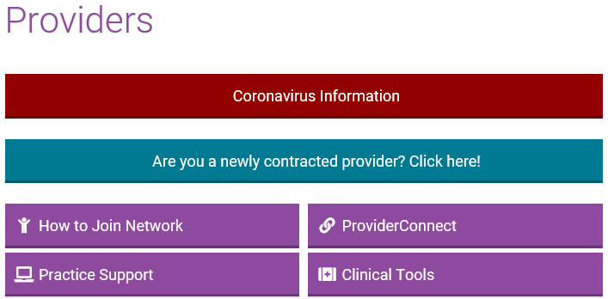
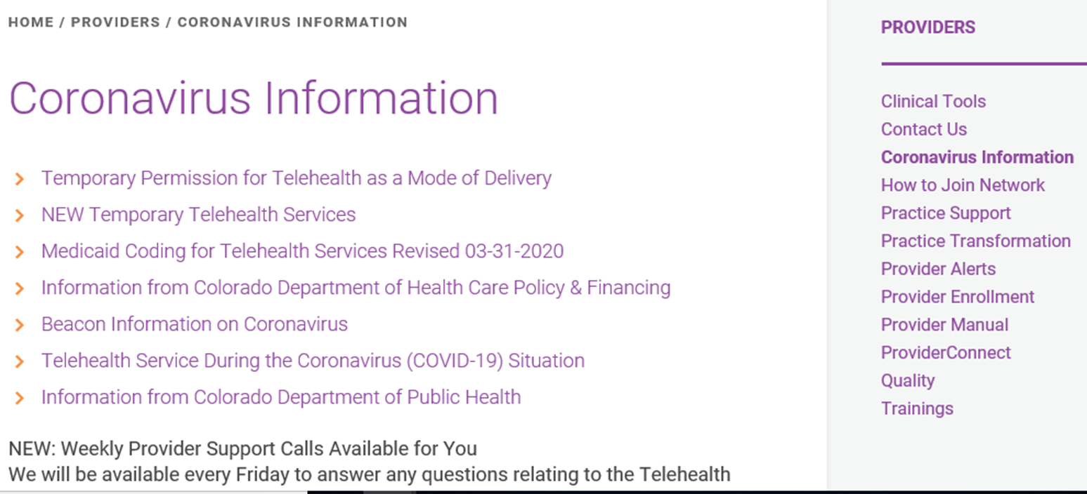
COVID-19 How to Access Updates on the RAE Websites
Go to the RAE website, either healthcoloradorae.com or northeasthealthpartners.org
Click on the Providers section
On the Providers tab click on the red CORONAVIRUS INFORMATION banner
Notes:
healthcoloradorae.com
northeasthealthpartners.org

Slide 13
COVID-19 Updates
Recent updates Released ;
  The list of service codes which allow telehealth has been expanded
  Telehealth services should include the Place of Service code 02
  Verbal Consent to Treatment is allowed during this State of Emergency. Signed consent to treatment is preferable and should be obtained whenever possible but should not be a barrier to treatment.
    Be sure to DOCUMENT this consent and any other unique circumstance in the members record.
Notes:
Link to the coding list
https://www.healthcoloradorae.com/providers/coronavirus-information/

Slide 14
COVID-19 Updates - Claims
Telehealth codes prior to the State of Emergency – No change or delay, bill as usual.
New Codes allowing Telehealth during the State of Emergency – We are working to get these codes programmed to allow Telehealth. Should you have a claim denial we will reprocess claims received when the codes are programmed.
Authorizations or Single Case Agreements (SCA) – If you have an authorization for services and did not request for the services to be delivered via Telehealth, please call to update your authorization
Health Colorado call 888-502-4185
Northeast Health Partners call 888-502-4189

Slide 15




COVID-19 Resources

Slide 16

Reminders
04

Slide 17
Reminders
CPAC Program
Please share any Training Areas we can support you with.
Online Trauma Informed Training Coming Soon!
  Save the Date! June 19 & 20 (4 hour sessions each day) 9:30am – 3:00pm.
  Registration information coming soon

Slide 18
Questions
&
Open Discussion
05

Slide 19
Contact Us
888-502-4189 | 888-502-4185
www.northeasthealthpartners.org | www.healthcoloradorae.com
northeasthealthpartners@beaconhealthoptions.com
healthcolorado@beaconhealthoptions.com

