Slide 1
Thank you for joining us, we will get started in just a few minutes to allow others to call in.
Please make sure your line is muted.
To receive the slides shared today please email COProviderRelations@BeaconHealthOptions.com

Slide 2
May Weekly Provider Support Call

Slide 3
Agenda
01 | Welcome & Introductions
02 | Recent Updates
03 | COVID-19 – How to Stay Updated & Updates
04 | Reminders
05 | Questions & Open Discussion

Slide 4
Welcome and Introductions
Thank you for joining the May Provider Support Call
01
Notes:
Every Friday in the month of April we will conduct a Provider Support Call

Slide 5
Updates
E&M Codes
Clinical Innovations Webinar
ConnectToCareJobs.com
02

Slide 6
Updates – E&M Codes
If you are a provider that bills Evaluation and Management codes (E&M) please ensure you are familiar with Appendix J (pages 399-400) in the Uniform Service Coding Manual which can be found at https://www.colorado.gov/pacific/hcpf/mental-health-rate-reform-0
A provider alert regarding this change was sent out 4/15/2020.
Evaluation and Management (E&M) Codes for Consultation, Emergency Department and Add-on services are reimbursed under the Capitated Behavioral Health Benefit. These services may be billed to Beacon, if they are included in your contract.
However, Evaluation and Management (E&M) Codes other than those noted above are reimbursed under the Capitated Behavioral Health Benefit only for providers with billing provider types considered Behavioral Health Specialty. This billing change applies to dates of service commencing July 1, 2018.
Providers types that are not considered Behavioral Health Specialty or codes not covered by the Capitated Behavioral Health benefit must bill to Medicaid Fee-For-Service.

Slide 7
First webinar in Clinical Innovations Telehealth Series: Telehealth and Suicide Care → May 19 @ 11am Current conditions demand finding ways to safely work with suicidal individuals using telehealth. This webinar, the first in the series and co-hosted by the Suicide Prevention Resource Center, will provide pragmatic guidance for evaluating and managing suicide risk via telehealth. In particular, adaptations to do remote screening and risk assessment will be discussed as well as how to effectively conduct safety planning with people at risk. Resources to immediately implement these strategies will be shared. Registration: There is no fee for this webinar but registration is required using the link below. https://mhttcnetwork.org/centers/global-mhttc/event/clinical-innovations-telehealth- telehealth-and-suicide-care

Slide 8
New Website Launches to Help Address Health Care Workforce Shortages and Improve Care ConnectToCareJobs.com The Department of Health Care Policy & Financing (HCPF), Advancing States and Centene Corporation have come together in a unique public-private partnership to develop and launch ConnectToCareJobs.com, a new website to help address health care workforce shortages during the coronavirus disease (COVID-19) public health emergency and beyond. The site will connect residential care facilities (like nursing homes and assisted living facilities) that need employees with health care professionals who need jobs.

Slide 9
COVID – 19
How to Stay Updated
& Current Updates
03

Slide 10
COVID-19 How to Stay Updated
As there are updates or changes in information you can access information the following ways;
RAE websites are updated with the most current information as soon as possible
RAE websites immediately offer the option to be connect with COVID-19 information provided by the state of Colorado.
Provider Alert emails are sent out
As always please contact us with any questions you may have at COProviderRelations@BeaconHealthOptions.com
Notes:
If you are not receiving Provider Alert emails please let us know so that we can verify the contact information we have.

Slide 11
COVID-19 How to Stay Updated – State of Colorado Websites
State of Colorado Website Resources for providers;
https://www.colorado.gov/hcpf/covid
https://www.colorado.gov/hcpf/provider-telemedicine
https://www.colorado.gov/hcpf/provider-news

Slide 12
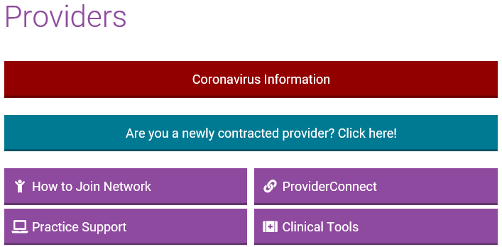
COVID-19 How to Access Updates on the RAE Websites
Go to the RAE website, either healthcoloradorae.com or northeasthealthpartners.org
Click on the Providers section
On the Providers tab click on the red CORONAVIRUS INFORMATION banner
Notes:
healthcoloradorae.com
northeasthealthpartners.org

Slide 13
COVID-19 How to Access Updates on the RAE Websites
Notes:
This is the Coronavirus Information page, this is where you can find resources and updates.

Slide 14
COVID-19 Updates
Recent updates Released ;
The list of service codes which allow telehealth has been expanded
Telehealth services should include the Place of Service code 02
Verbal Consent to Treatment is allowed during this State of Emergency. Signed consent to treatment is preferable and should be obtained whenever possible but should not be a barrier to treatment.
Be sure to DOCUMENT this consent and any other unique circumstance in the members record.
Notes:
Link to the coding list
https://www.healthcoloradorae.com/providers/coronavirus-information/

Slide 15
COVID-19 Updates - Claims
Telehealth codes prior to the State of Emergency – No change or delay, bill as usual.
New Codes allowing Telehealth during the State of Emergency – We are working to get these codes programmed to allow Telehealth. Should you have a claim denial we will reprocess claims received when the codes are programmed.
Authorizations or Single Case Agreements (SCA) – If you have an authorization for services and did not request for the services to be delivered via Telehealth, please call to update your authorization
Health Colorado call 888-502-4185
Northeast Health Partners call 888-502-4189

Slide 16
COVID-19 Resources

Slide 17
Reminders
04

Slide 18
Reminders
CPAC Program
Please share any Training Areas we can support you with.
Online Trauma Informed Training Coming Soon!
Save the Date! June 19 & 20 (4 hour sessions each day). Details and Registration information coming soon.

Slide 19
Questions
&
Open Discussion
05

Slide 20
Contact Us
888-502-4189 | 888-502-4185
www.northeasthealthpartners.org | www.healthcoloradorae.com
northeasthealthpartners@beaconhealthoptions.com
healthcolorado@beaconhealthoptions.com

