Slide 1
April Weekly Provider Support Call

Slide 2
Agenda
01 | Welcome & Introductions
02 | New Outpatient Authorization Requirements
03 | COVID-19 – Updates and How to Stay Updated
04 | Questions and Answers

Slide 3
Welcome and Introductions
01
Thank you for joining the April Provider Support Call
Notes:
Every Friday in the month of April we will conduct a Provider Support Call

Slide 4
New Authorization Requirements for In-Network Providers
02

Slide 5
New Provider-Friendly & Member-Centered Process
Starting April 1, 2020
ONE authorization process for members assigned to Health Colorado and Northeast Health Partners
** The full presentation from February on the authorization process is located on the RAE websites under the provider Training section
Either healthcoloradorae.com or northeasthealthpartners.org
Providers Tab → Trainings → Behavioral Health Outpatient Authorization Presentation

Slide 6
Outpatient Mental Health Authorization Process
Sessions 1-25:
No authorization is required for In-Network providers for the first 25 units (total in any combination) of the following codes:
90791, 90832, 90834, 90837, 90846 and 90847.
It is expected that the assessment be completed within these sessions.
The first 25 sessions without authorization are allowed once in a 12-month calendar year.
For the first year, 25 sessions will be counted from April 1, 2020 to December 31, 2020.

Slide 7
COVID – 19
How to Stay Updated
& Current Updates
03

Slide 8
COVID-19 How to Stay Updated
As there are updates or changes in information you can access information the following ways;
RAE websites are updated with the most current information as soon as possible
RAE websites immediately offer the option to be connect with COVID-19 information provided by the state of Colorado.
Provider Alert emails are sent out
As always please contact us with any questions you may have at COProviderRelations@BeaconHealthOptions.com
Notes:
If you are not receiving Provider Alert emails please let us know so that we can verify the contact information we have.

Slide 9
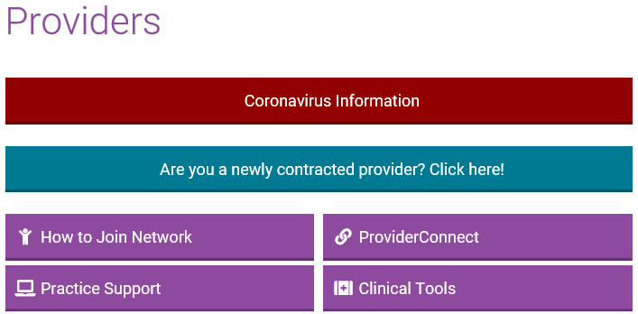
COVID-19 How to Access Updates on the RAE Websites
Go to the RAE website, either healthcoloradorae.com or northeasthealthpartners.org
Click on the Providers section
On the Providers tab click on the red CORONAVIRUS INFORMATION banner
Notes:
healthcoloradorae.com
northeasthealthpartners.org

Slide 10
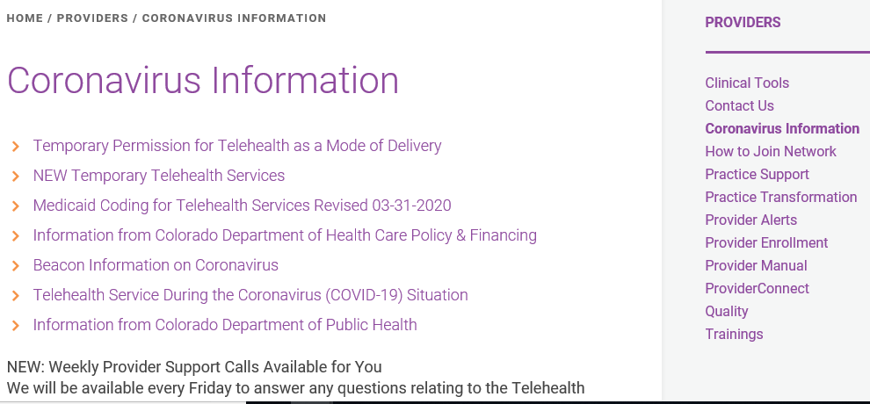
COVID-19 How to Access Updates on the RAE Websites
Notes:
This is the Coronavirus Information page, this is where you can find resources and updates.

Slide 11
COVID-19 Updates
Recent updates Released ;
Medicaid Coding list for Telehealth Services Revised
  The list of service codes which allow telehealth has been expanded
  Telehealth services should include the Place of Service code 02
  Verbal Consent to Treatment is allowed during this State of Emergency. Signed consent to treatment is preferable and should be obtained whenever possible but should not be a barrier to treatment.
    Be sure to DOCUMENT this consent and any other unique circumstance in the members record.
Notes:
Link to the coding list
https://www.healthcoloradorae.com/providers/coronavirus-information/

Slide 12
COVID-19 Updates - Claims
Telehealth codes prior to the State of Emergency – No change or delay, bill as usual.
New Codes allowing Telehealth during the State of Emergency – We are working to get these codes programmed to allow Telehealth. Should you have a claim denial we will reprocess claims received when the codes are programmed.
Authorizations or Single Case Agreements (SCA) – If you have an authorization for services and did not request for the services to be delivered via Telehealth, please call to update your authorization
Health Colorado call 888-502-4185
Northeast Health Partners call 888-502-4189

Slide 13
Questions and Answers
04

Slide 14
Contact Us
888-502-4189 | 888-502-4185
www.northeasthealthpartners.org | www.healthcoloradorae.com
northeasthealthpartners@beaconhealthoptions.com
healthcolorado@beaconhealthoptions.com

